Slide 1

HR Analytics Project Report
Workforce Stability & Performance Analysis
1. Executive Summary
This project focuses on analyzing workforce data to understand employee attrition, engagement, and performance across the organization. The objective was to create a structured, end‑to‑end HR analytics solution—starting from raw data, cleaning and transformation, database storage, and finally interactive dashboards in Power BI. The outcome is a decision‑ready HR Analytics Dashboard that helps leadership identify workforce risks, performance gaps, and hiring effectiveness.

Slide 2
2. Business Context
2.1 Business Problem
Organizations often face challenges related to:
High employee attrition without clear visibility into root causes
Inconsistent performance and engagement across departments
Difficulty identifying at‑risk employee groups early
Limited insight into whether hiring channels are producing high‑quality, long‑term employees
Without data‑driven insights, HR and leadership teams rely on assumptions rather than evidence‑based decisions.

Slide 3
2.2 Business Goal
To improve workforce stability and performance by identifying the key drivers of employee attrition, engagement, and performance across departments and roles.

Slide 4
2.3 Project Objectives
Analyze employee attrition trends and identify high‑risk departments
1
Understand the relationship between engagement, satisfaction, performance, and attrition
2
Evaluate workforce composition and diversity
3
Assess the effectiveness of recruitment sources
4
Deliver clear, executive‑friendly dashboards for decision‑making
5

Slide 5
3. Dataset Overview
3.1 Data Description
The dataset represents HR employee‑level data including:
Employee demographics (gender, age, race, location)
Employment details (department, position, manager, employment status)
Performance and engagement metrics
Attrition and termination details
Recruitment source information
Each row represents one employee record.
3.2 Key Variables
EmpID – Unique employee identifier
Department / Position / ManagerName – Organizational structure
Attrition – Employee status (0 = Active, 1 = Left)
PerformanceScore – Employee performance rating
EngagementSurvey / EmpSatisfaction – Engagement and satisfaction scores
Absences – Attendance indicator
RecruitmentSource – Hiring channel
DOB, DateofHire, DateofTermination – Time‑based attributes

Slide 6
4. Data Analysis Pipeline
4.1 Tools Used
Python (Pandas, NumPy) – Data cleaning, feature engineering
CSV – Data exchange format
MySQL – Centralized data storage (single source of truth)
Power BI – Data modeling, visualization, and dashboarding

Slide 7
5. Data Cleaning & Preparation (Python)
5.1 Missing Value Analysis
Identified missing values in DOB, DateofHire, DateofTermination
Derived fields such as Age and Tenure_Years naturally contained nulls where source dates were missing
Nulls were intentionally preserved to avoid creating artificial data

Slide 8
5.2 Feature Engineering
Age calculated from DOB
01
Tenure_Years calculated from DateofHire and DateofTermination
02
Engagement Level bucketed into Low / Medium / High
03
Age Group created for demographic analysis
04

Slide 9
5.3 Date Handling
All date columns standardized to ISO format (YYYY‑MM‑DD)
Ensured compatibility with SQL and Power BI

Slide 10
5.4 Export
Final cleaned dataset exported as CSV
Imported into MySQL to serve as the analytical data source

Slide 11
6. Database Layer (MySQL)
6.1 Purpose
Act as a single source of truth
Enable scalable reporting and BI integration
Maintain data consistency across dashboards
6.2 Validation
Row counts verified between Python and SQL
Data types validated for dates, numeric, and categorical fields

Slide 12
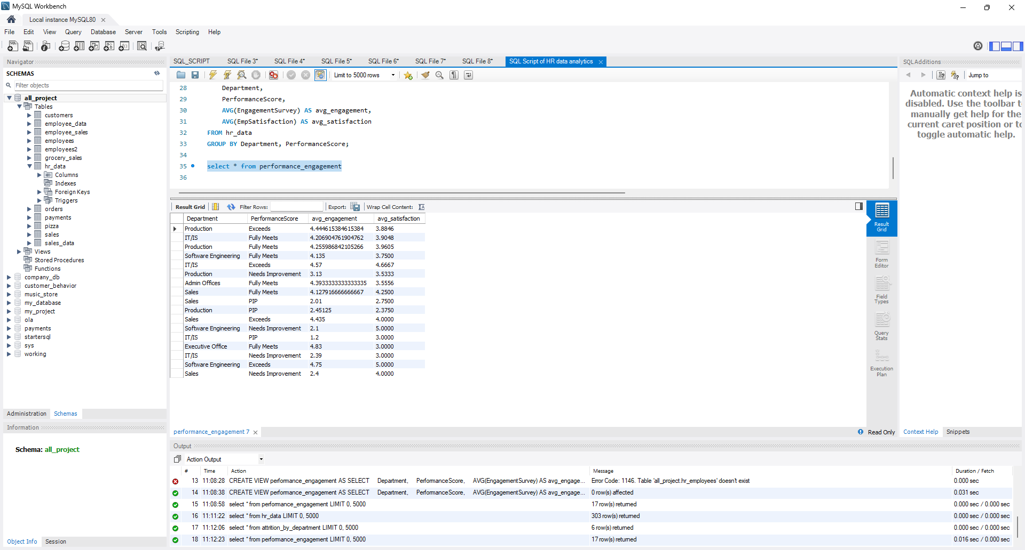
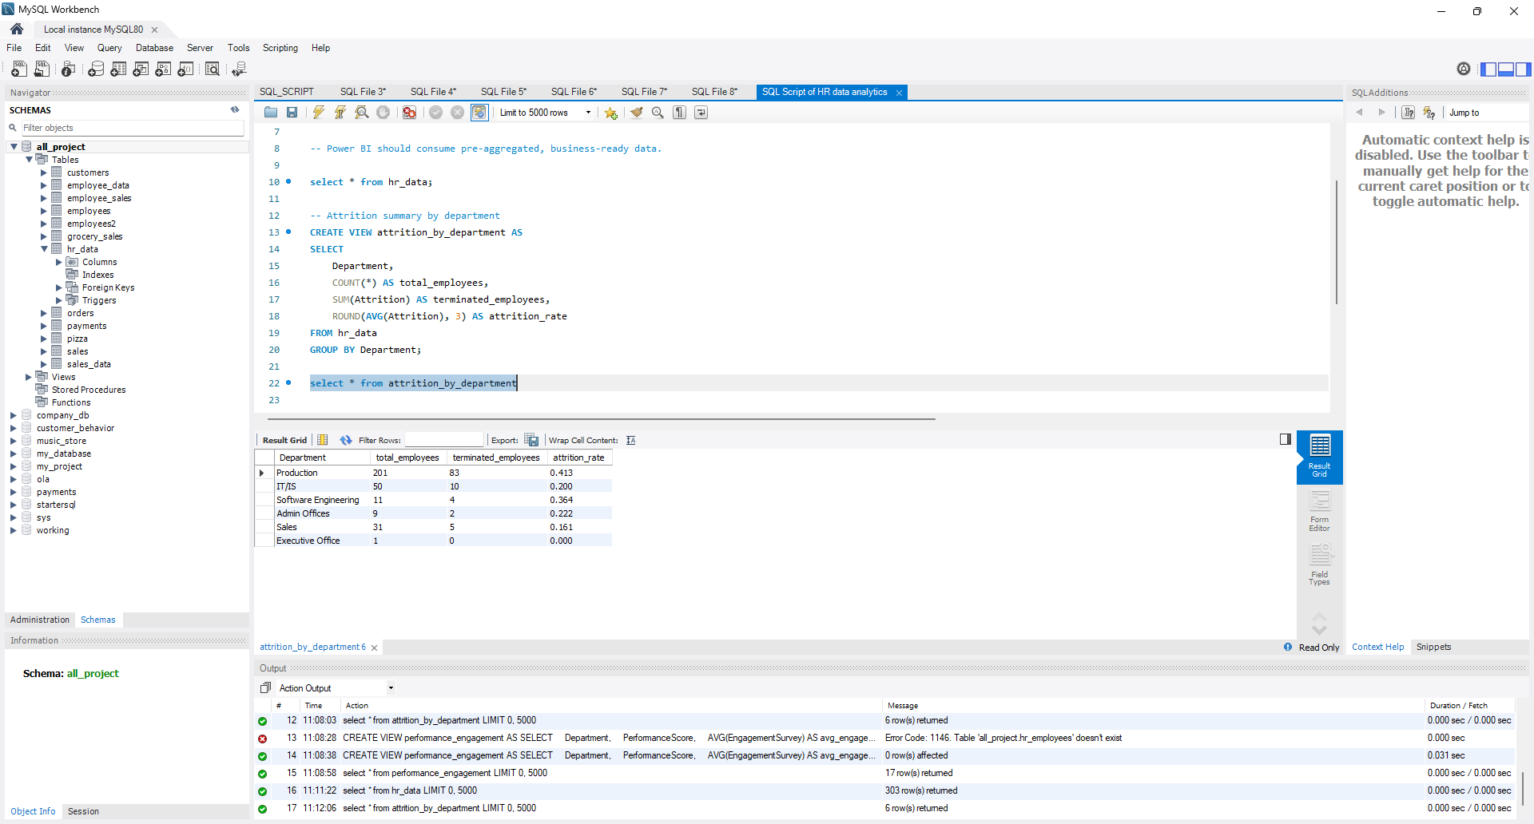
My SQL work Screenshots

Slide 13
7. Power BI Data Modeling
7.1 Measures Created
Total Employees
Active Employees
Attrition Rate (%)
Average Performance Score
Department‑wise engagement and satisfaction comparison
7.2 Design Decisions
Gender used consistently as a legend across all visuals (Male/Female)
Consistent color usage across all pages for clarity and comparison
Limited filters per page to avoid clutter and improve usability

Slide 14
8. Dashboard Structure & Insights
Page 1: Executive Workforce Overview
Business Question: How healthy is our workforce right now?
Key insights:
Overall attrition rate and workforce size
Attrition trends over time
Department‑level workforce distribution
Location‑wise attrition patterns

Slide 15
Page 2: Attrition Drivers & Risk Analysis
Business Question: Who is leaving, and why?
Key insights:
High‑attrition departments
Attrition by performance level
Attrition by engagement level
Top reasons for termination

Slide 16
Page 3: Performance & Engagement Insights
Business Question: How well are employees performing and how engaged are they?
Key insights:
Performance score distribution
Relationship between engagement and satisfaction
Identification of at‑risk employee groups
Department‑wise engagement and satisfaction comparison

Slide 17
9. Business Solutions & Recommendations
Based on the analysis:
Targeted Retention Strategies
Focus on departments with consistently high attrition
Address engagement gaps before they lead to exits
Performance Management Improvements
Monitor low‑performance and low‑engagement clusters
Use early warning indicators such as absenteeism
Hiring Optimization
Prioritize recruitment sources associated with lower attrition and higher performance
Reduce dependence on channels producing high turnover
Diversity & Workforce Planning
Use demographic insights to support inclusive workforce planning
Align hiring with long‑term organizational needs

Slide 18
10. Conclusion
This HR Analytics project demonstrates a complete, real‑world data analysis workflow—from raw data to executive‑ready insights. By integrating Python, SQL, and Power BI, the project delivers actionable intelligence that supports strategic HR decisions. The final dashboards enable leadership to proactively manage attrition, improve engagement, and strengthen workforce stability.

Slide 19
11. Future Enhancements
Predictive attrition modeling using machine learning
Employee‑level risk scoring
Automated data refresh and scheduled reporting
Integration with payroll and performance management systems

